Slide 1

Department of Computer Science and Engineering
191CS161A – Mini Project Work – Review I
Real-time Sign Language Detection
Team Members:
Devanand M - 113119UG03019
Prinfert Danish P A - 113119UG03075
Harishkumar R - 113119UG03032
Guided by,
Dr. N GANESH M.E.[CSE]., MBA[HR]., M.L.[IPR]., Ph.D.[CSE] , Dean and Professor,
Dept of CSE.
Batch No: 01
Date : 21.06.2022

Slide 2
OUTLINE OF THE PRESENTATION
Objective
Abstract
Introduction
Motivation
Problem statement
Software and Hardware Requirement
Proposed Work
Result
Conclusion & Future work
References
2

Slide 3
Objective
Communication is always having a great impact in every domain and how it is considered the meaning of the thoughts and expressions that attract the researchers to bridge this gap for every living being . The objective of this project is to identify the symbolic expression through images so that the communication gap between a normal and hearing impaired person can be easily bridged.

Slide 4
Abstract
Sign languages are a set of predefined languages which use visual-manual modality to convey information . We consider the problem of real time Indian Sign Language (ISL) finger recognition . We collected a dataset of depth based segmented RGB image using Logitech C720HD Camera for classifying few different gestures (actions) . The system takes in a hand gesture as input and returns the corresponding recognized character as output in real time on the monitor screen . For classification we used Deep Convolutional Neural Network and achieved an accuracy of 97.70%.

Slide 5
Introduction
The world is hardly live without communication, no matter whether it is in the form of texture, voice or visual expression.
The communication among the deaf and dumb people carried by text and visual expression.
Gestural communication is always in the scope of confidential and secure communication.
Hands and facial parts are immensely influential to express the thoughts of human in confidential communication.

Slide 6
Motivation
Sign language is learned by deaf and dumb, and usually it is not known to normal people, so it becomes a challenge for communication between a normal and hearing impaired person.
Its strike to our mind to bridge the between hearing impaired and normal people to make the communication easier.
Sign language recognition (SLR) system takes an input expression from the hearing impaired person gives output to the normal person in the form text or voice

Slide 7
Problem Statement
Understanding the exact context of symbolic expressions of deaf and dumb people is the challenging job in real life until unless it is properly specified.

Slide 8
Software Requirements
Software Tool : VSCode
Operating System : Windows 10
Processors : Any Intel or AMD X86-64 processor
RAM : 8GB
Graphics Card : GTX 1050 ti graphics card required
Packages Used : TensorFlow , Keras , Open CV , MediaPipe , Streamlit.

Slide 9
Hardware Requirements
Operating System : Windows XP / Windows Vista
Processor : Intel i3 9100f
Video card : NVIDIA Ge Force GTX 1650 super
Memory : 8GB RAM
Resolution : 1024*768 minimum display resolution
Webcam : Min. 720 pixels

Slide 10
Proposed work
In this work, we proposed an idea for feasible communication between hearing impaired and normal person with the help of
Deep Learning
CNN
Tensorflow
Machine Learning
KNN
OpenCV
Keras
Streamlit – to deploy project as a web application.

Slide 11
Tensorflow
TensorFlow is an open-source software library. TensorFlow was originally developed by researchers and engineers working on the Google Brain Team within Google’s Machine Intelligence research organization for the purposes of conducting machine learning and deep neural networks research, but the system is general enough to be applicable in a wide variety of other domains as well!

Slide 12
Open CV
OpenCV is a huge open-source library for computer vision, machine learning, and image processing.
OpenCV supports a wide variety of programming languages like Python, C++, Java, etc.
It can process images and videos to identify objects, faces, or even the handwriting of a human.
When it is integrated with various libraries, such as Numpy which is a highly optimized library for numerical operations, then the number of weapons increases in your Arsenal i.e. whatever operations one can do in Numpy can be combined with OpenCV.

Slide 13
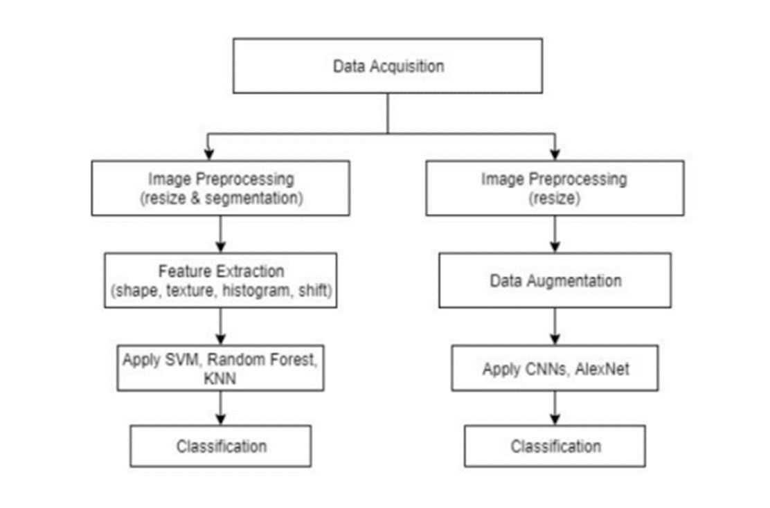
Work Flow diagram

Slide 14
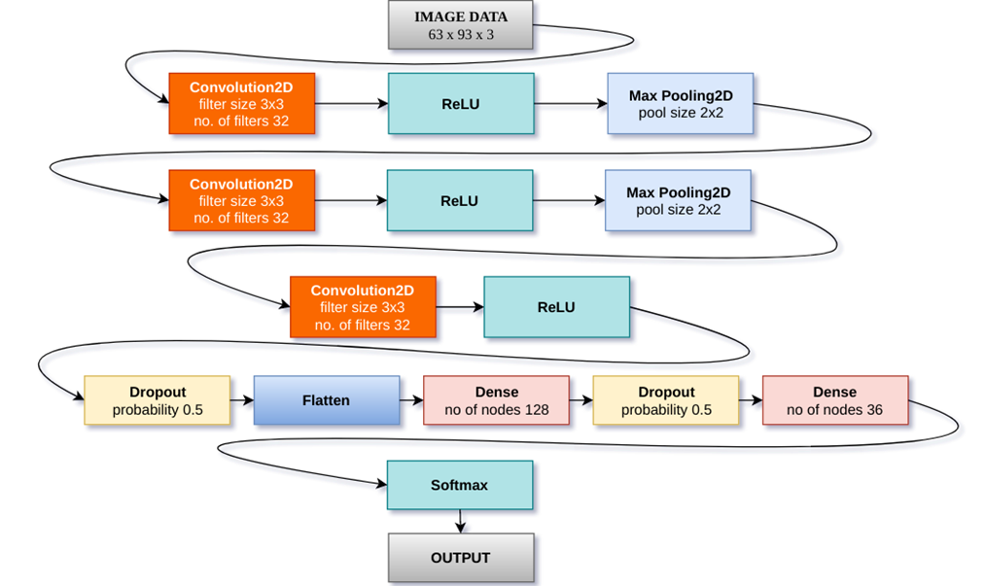
Architecture CNN model

Slide 15
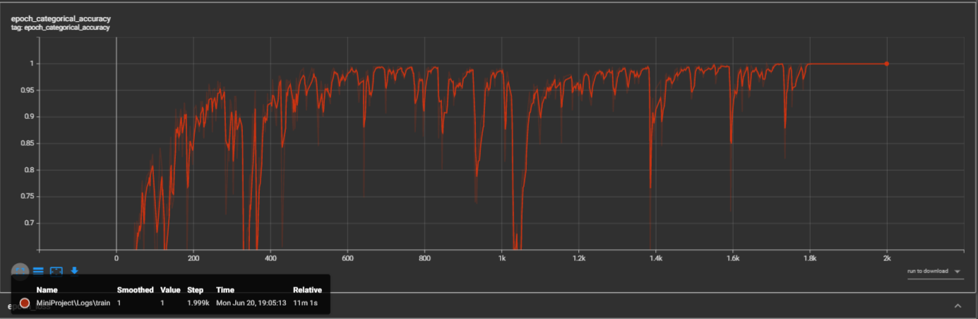
Result – Variation of Accuracy

Slide 16
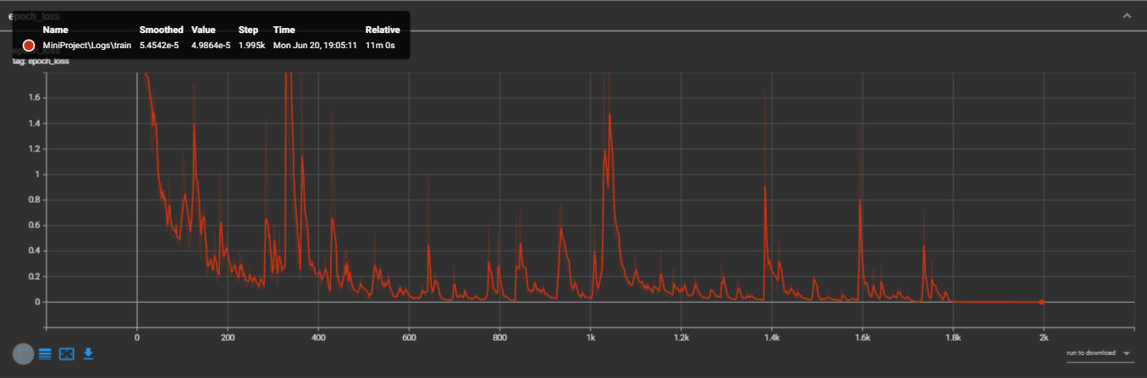
Variation of Losses

Slide 17
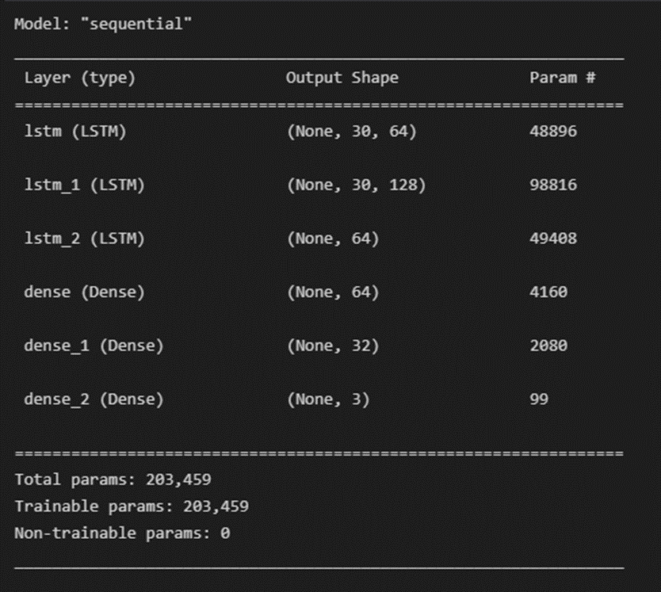
CNN Model Summary

Slide 18
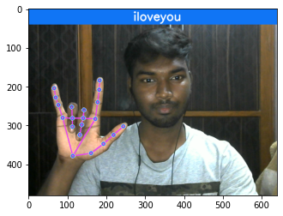
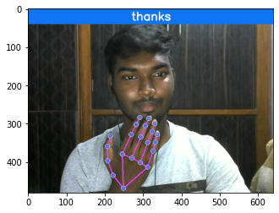
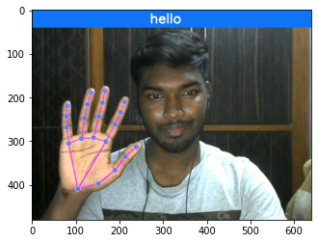
Outputs

Slide 19
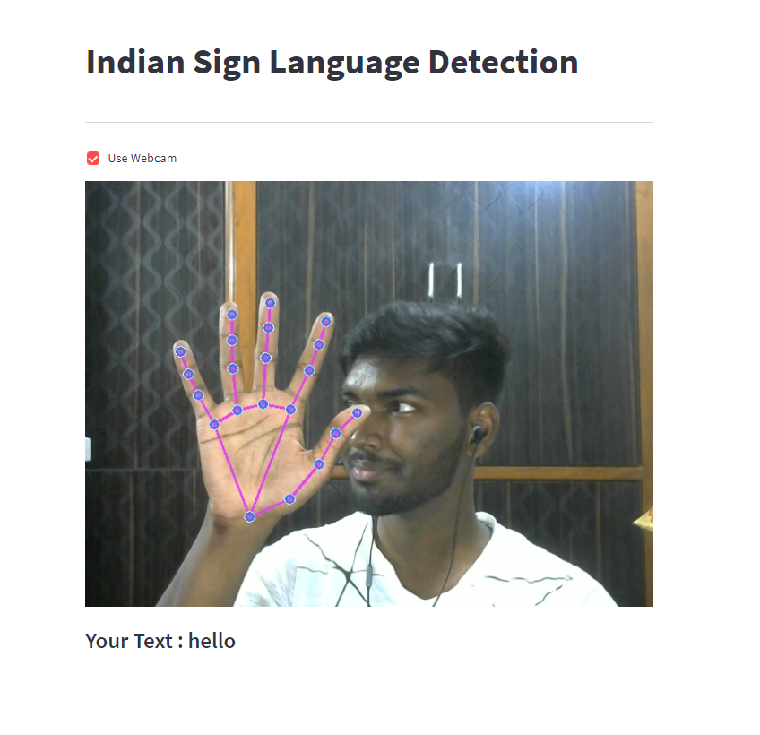
Final Output
This is the final output of our proposed work after implementing as web application

Slide 20
Conclusion & Future work
In this project, we proposed an idea for feasible communication between hearing impaired and normal person with the help of deep learning and machine learning approach.
This proposed work ensures the accuracy of 99.79 using TensorFlow and LSTM.
There is ever the sounding challenge to develop a sign language system in data the collection remains invariant of the unconstraint environment. This project can be extended to the real time data.

Slide 21
References
[1] Ameen, S., & Vadera, S. (2017). A convolutional neural network to classify American Sign Language fingerspelling from depth and colour images. Expert Systems.
[2] Naresh Kumar (2017). Sign Language Recognition for Hearing Impaired People based on Hands Symbols Classification. International Conference on Computing, Communication and Automation (ICCCA2017)
[3] Menna ElBadawy, A. S. Elons, Howida A. Shedeed and M. F. Tolba. Arabic sign language recognition with 3D convolutional neural networks. 2017 Eighth International Conference on Intelligent Computing and Information Systems (ICICIS)
[4] Pan, T. Y., Lo, L. Y., Yeh, C. W., Li, J. W., Liu, H. T., & Hu, M. C.(2016, April). Real-time sign language recognition in complex background scene based on a hierarchical clustering classification method. In Multimedia Big Data (BigMM), 2016 IEEE Second International Conference on (pp. 64-67). IEEE.

Slide 22
Cont.
[5] Pigou, L., Dieleman, S., Kindermans, P. J., & Schrauwen, B. (2014, September). Sign language recognition using convolutional neural networks. In Workshop at the European Conference on Computer Vision (pp. 572-578). Springer International Publishing.
[6] Sutskever, I., Martens, J., Dahl, G., Hinton, G.: On the importance of initialization and momentum in deep learning. In: Proceedings of the 30th International Conference on Machine Learning (ICML-13). pp. 1139{1147 (2013)
[7] Tao Liu, Wengang Zhou, and Houqiang Li. Sign Language Recognition With Long Short-Term Memory 2016 IEEE International Conference on Image Processing (ICIP).

Slide 23
THANK YOU

